Slide 1


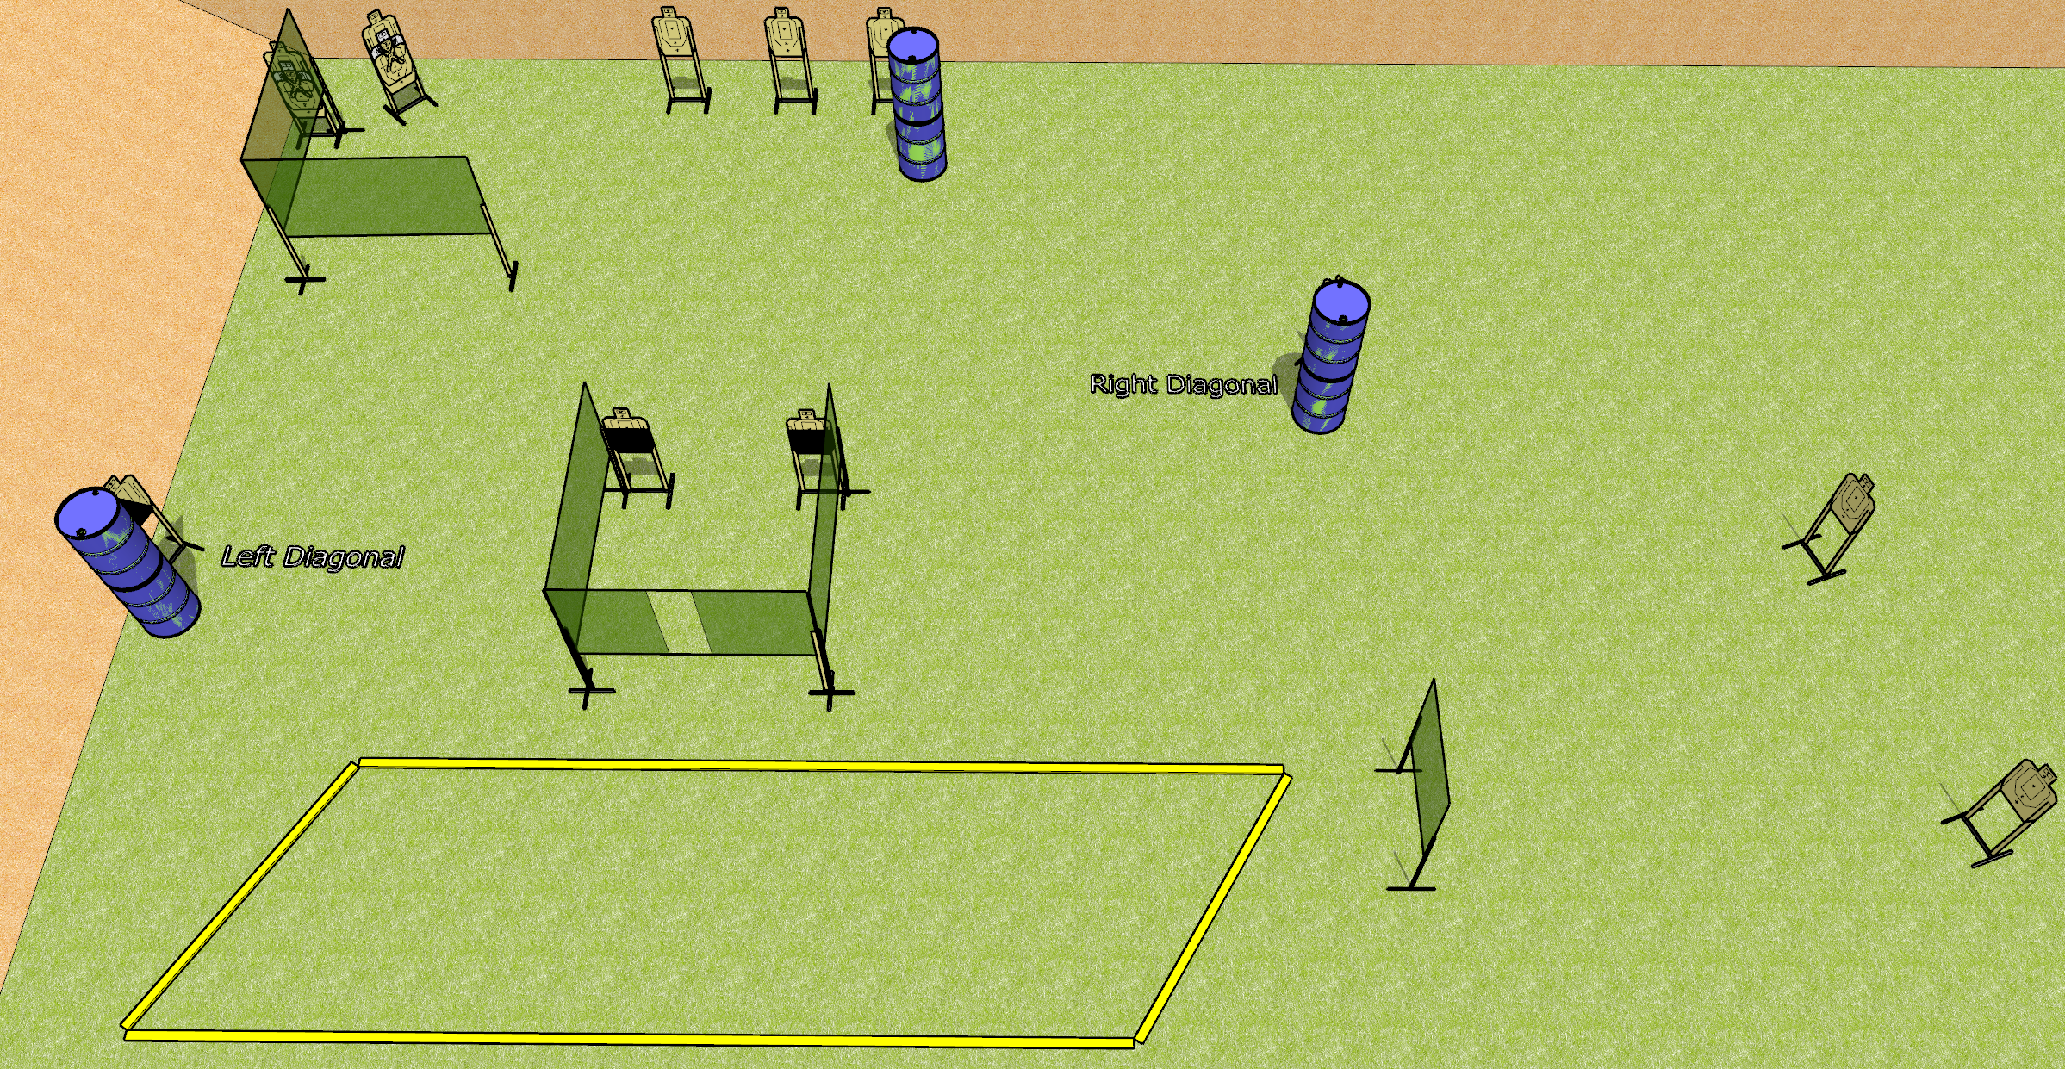
 | Dothan Gun Club – USPSA Match Rhombus of Annoyance Course Designer : Drew Coleman
Round Count 26 rounds 13 USPSA
Equipment List 9 wall feet 1 left and 1 right diag, 2 50% All 10’ fault lines

Slide 2
Rhombus of Annoyance
Written Stage Briefing
Rhombus of Annoyance is a 26 round, 130 point, Comstock course of fire. There are 13 USPSA targets. The best 2 hits on paper will score. The start signal is audible.
Handgun start position is inside the shooting area, wrists below belt. Handgun is loaded and holstered.
PCC start position is inside the shooting area, stock on belt. Loaded carbine is held with both hands, safety on.
On start signal, engage targets as they become available from within the shooting area.

